Slide 1

Statistical Methods for Evaluation – 1
OMIS 665 – Big Data Analytics for Business
Assistant Professor of MIS
Ying Wang, Ph.D.

Slide 2
Statistical Inference – drawing conclusions based on data
Sampling
Estimation
estimate a population characteristic, such as mean, variance, percentiles
Typical approaches: point estimation, interval estimation
Hypothesis testing
evaluate an assertion about populations of interest
Example: is the mean of Population A different than the mean of Population B?
common techniques
T-test (assumes normal distribution)
Wilcoxon Rank-Sum (non-parametric)
Analysis of Variance (ANOVA)

Slide 3
Statistical Sampling

Slide 4
Sampling Methods
Subjective Methods
Judgment sampling – expert judgment is used to select the sample
Survey the “best” customers
Convenience sampling – samples are selected based on the ease with which the data can be collected
Survey all customers who happened to visit this month
Probabilistic Sampling
Simple random sampling involves selecting items from a population so that every subset of a given size has an equal chance of being selected

Slide 5
Additional Probabilistic Sampling Methods
Systematic (periodic) sampling – a sampling plan that selects every n^{th} item from the population.
Can induce significant bias if the population has some underlying pattern
Stratified sampling – applies to populations that are divided into natural subsets (called strata) and allocates the appropriate proportion of samples to each stratum.
population
Sample
City 1
City 1
City 3
City 3
City 2
City 2

Slide 6
Additional Probabilistic Sampling Methods
Cluster sampling - based on dividing a population into subgroups (clusters), sampling a set of clusters, and (usually) conducting a complete census within the clusters sampled
Sampling from a continuous process
Select a time at random; then select the next n items produced after that time.
Select n times at random; then select the next item produced after each of these times.
population
Sample
City 1
City 3
City 1
City 2

Slide 7
Estimation

Slide 8
Estimating Population Parameters
Estimation involves assessing the value of an unknown population parameter using sample data
Estimators are the measures used to estimate population parameters
E.g., sample mean, sample variance, sample proportion
A point estimate is a single number derived from sample data that is used to estimate the value of a population parameter.
If the expected value of an estimator equals the population parameter it is intended to estimate, the estimator is said to be unbiased.

Slide 9
Interval Estimates
An interval estimate provides a range for a population characteristic based on a sample.
Intervals specify a range of plausible values for the characteristic of interest and a way of assessing “how plausible” they are.
In general, a 100(1 - a)% probability interval is any interval [A, B] such that the probability of falling between A and B is 1 - a.
Probability intervals are often centered on the mean or median.
Example: in a normal distribution, the mean plus or minus 1 standard deviation describes an approximate 68% probability interval around the mean.

Slide 10
Example – Interval Estimates in the News
A Gallup poll might report that 56% of voters support a certain candidate with a margin of error of ± 3%.
We would have a lot of confidence that the candidate would win since the interval estimate is [53%, 59%]
Suppose the poll reported a 52% level of support with a ± 4% margin of error.
We would be less confident in predicting a win for the candidate since the interval estimate is [48%, 56%].

Slide 11
Confidence Intervals
A confidence interval is a range of values between which the value of the population parameter is believed to be, along with a probability that the interval correctly estimates the true (unknown) population parameter.
This probability is called the level of confidence, denoted by 1 - α, where α is a number between 0 and 1.
The level of confidence is usually expressed as a percent; common values are 90%, 95%, or 99%.
For a 95% confidence interval, if we chose 100 different samples, leading to 100 different interval estimates, we would expect that 95% of them would contain the true population mean.

Slide 12
Hypothesis Testing

Slide 13
Hypothesis Testing
Hypothesis testing involves drawing inferences about two contrasting propositions (each called a hypothesis) relating to the value of one or more population parameters.
H₀: Null hypothesis: describes an existing theory
H₁: Alternative hypothesis: the complement of H₀
Using sample data, we either:
- reject H₀ and conclude the sample data provides
sufficient evidence to support H_{1,} or
- fail to reject H₀ and conclude the sample data
does not support H_{1.}

Slide 14
Example – A Legal Analogy for Hypothesis Testing
In the U.S. legal system, a defendant is innocent until proven guilty.
H₀: Innocent
H₁: Guilty
If evidence (sample data) strongly indicates the defendant is guilty, then we reject H_{0.}
Note that we have not proven guilt or innocence!

Slide 15
Determining the Proper Form of Hypotheses
Hypothesis testing always assumes that H₀ is true and uses sample data to determine whether H₁ is more likely to be true.
Statistically, we cannot “prove” that H₀ is true; we can only fail to reject it.
Rejecting the null hypothesis provides strong evidence (in a statistical sense) that the null hypothesis is not true and that the alternative hypothesis is true.
Therefore, what we wish to provide evidence for statistically should be identified as the alternative hypothesis.

Slide 16
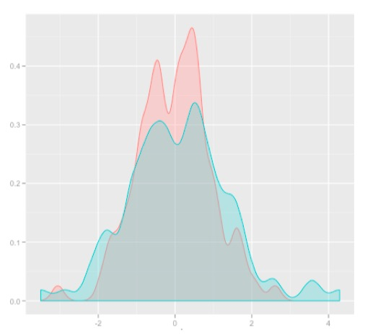
Hypothesis Testing
Fundamental question: “Is there a difference between the populations based on samples?”
examples: Mean
Null hypothesis: There is no difference
Alternative hypothesis: There is a difference
Using sample data, we either:
- reject H₀ and conclude the sample data provides sufficient evidence to support H_{1,} or
- fail to reject H₀ and conclude the sample data
does not support H_{1.}

Slide 17
Null and Alternative Hypotheses: Examples
Application | Null Hypothesis | Alternative Hypothesis
Accuracy Forecast | Model X does not predict better than the existing model. | Model X predicts better than the existing model.
Recommendation Engine | Algorithm Y does not produce better recommendations than the current algorithm being used. | Algorithm Y produces better recommendations than the current algorithm being used.
Regression Modeling | This variable does not affect the outcome because its coefficient is zero. | This variable affects outcome because its coefficient is not zero.

Slide 18
One-Sample Tests vs. Two-Samples Tests
One Sample Tests: Compare the parameter with a constant D₀
The Pizza Hut’s average delivery time ≤ 30 minutes
The average computer repair time ≤ 15 days
Two Samples Tests: Compare the difference between two samples with a constant D₀
Difference (Pizza Hut’s delivery time – Domino's delivery time) = 0

Slide 19
One-Sample Hypothesis Tests
Three types of one sample tests:
1. H₀: parameter ≤ constant; H₁: parameter > constant
2. H₀: parameter ≥ constant; H₁: parameter < constant
3. H₀: parameter = constant; H₁: parameter ≠ constant
It is not correct to formulate a null hypothesis using >, <, or ≠.

Slide 20
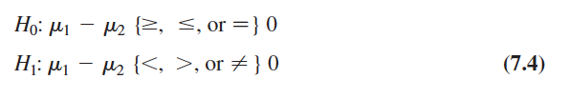
Two-Sample Tests for Difference in Means
Forms of the hypothesis test:

Slide 21
Upper-tailed, Lower-tailed, and Two-tailed Tests
 | One-Sample | Two-Sample
Upper-tailed | H₀: parameter ≤ constant H₁: parameter > constant | H₀: parameter(1) – parameter(2) ≤ 0 H₁: parameter(1) – parameter(2) > 0
Lower-tailed | H₀: parameter ≥ constant H₁: parameter < constant | H₀: parameter(1) – parameter(2) ≥ 0 H₁: parameter(1) – parameter(2) < 0
Two-tailed | H₀: parameter = constant H₁: parameter ≠ constant | H₀: parameter(1) – parameter(2) = 0 H₁: parameter(1) – parameter(2) ≠ 0

Slide 22
In-Class Exercise
A student claims that MBA students prepare more than 5 cases per week. (Upper-Tailed Hypothesis)
H₀: m <= 5 H₁: m > 5
Tom’s car gives a gas mileage of equal or more than 20 miles/gallon. Will installing new tires lower the mileage (Lower-Tailed Hypothesis)
H₀: m => 20 H₁: m < 20
A new cola bottling machine is installed. Is the mean volume different from12 oz (Two-Tailed Hypothesis)
H₀: m = 12 H₁: m ≠ 12

Slide 23
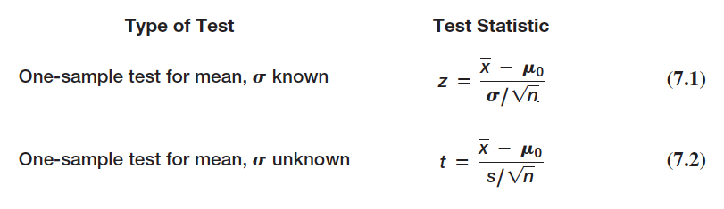
Selecting the Test Statistic
The decision to reject or fail to reject a null hypothesis is based on computing a test statistic from the sample data.
The test statistic used depends on the type of hypothesis test.
Test statistics for one-sample hypothesis tests for means:
(11.1)
(11.2)

Slide 24
Drawing a Conclusion
The conclusion to reject or fail to reject H₀ is based on comparing the value of the test statistic to a “critical value” from the sampling distribution of the test statistic when the null hypothesis is true and the chosen level of significance, a.
The sampling distribution of the test statistic is usually the normal distribution, t-distribution, or some other well-known distribution.
The critical value divides the sampling distribution into two parts, a rejection region and a non-rejection region. If the test statistic falls into the rejection region, we reject the null hypothesis; otherwise, we fail to reject it.

Slide 25
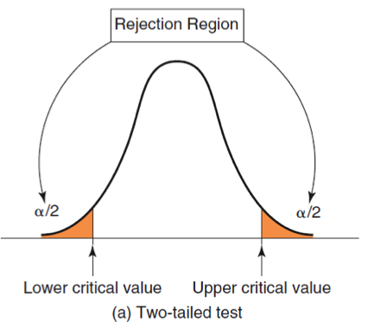
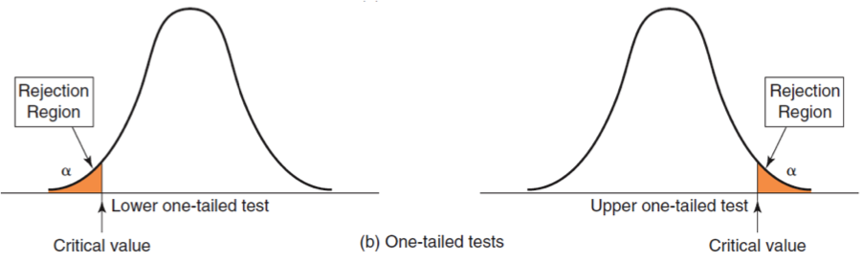
Rejection Regions for one-sample test
H₀: parameter ≥ constant
H₁: parameter < constant
H₀: parameter ≤ constant
H₁: parameter > constant
H₀: parameter = constant
H₁: parameter ≠ constant
For a one-tailed test, if H₁ is stated as <, the rejection region is in the lower tail; if H₁ is stated as >, the rejection region is in the upper tail (just think of the inequality as an arrow pointing to the proper tail direction).

Slide 26
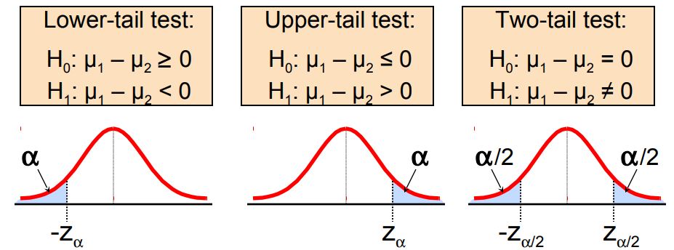
Two-Sample Tests for Difference in Means
Forms of the hypothesis test:
(11.4)

Slide 27
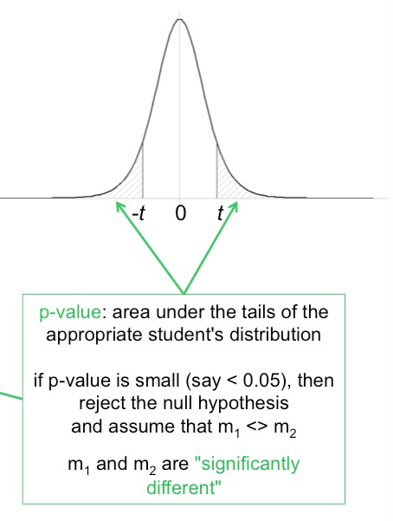
p-Values
A p-value (observed significance level) is the probability of obtaining a test statistic value equal to or more extreme than that obtained from the sample data when the null hypothesis is true.
Reject H₀ if the p-value < α

Slide 28
Hypothesis Testing: Summary
Set up hypotheses H0 and H1
Contrasting; “=“ always goes with H0
Calculate test score: z score, t score, f score, etc.
Compare test score with critical value determined by α and n.
Identify rejection region
Draw the conclusion: test score vs. critical value; p-value vs. α

Slide 29
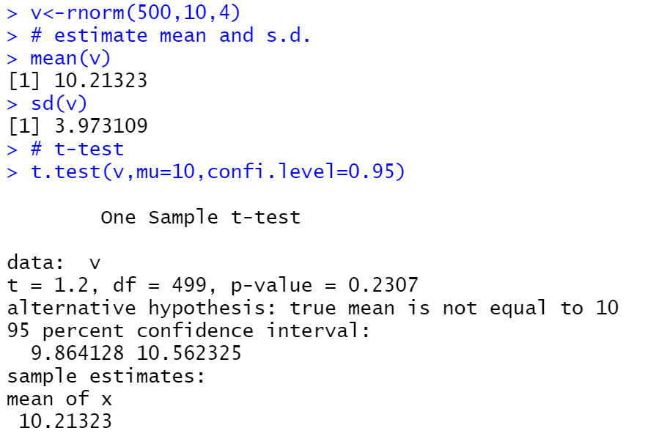
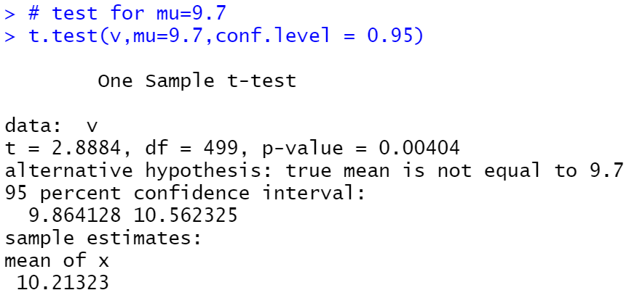
Student’s t-test
It assumes normal distribution.
One sample t-test determines whether the sample mean is statistically different from a known or hypothesized population mean.
Two sample t-test assumes that distributions of the two populations have equal but unknown variance.

Slide 30
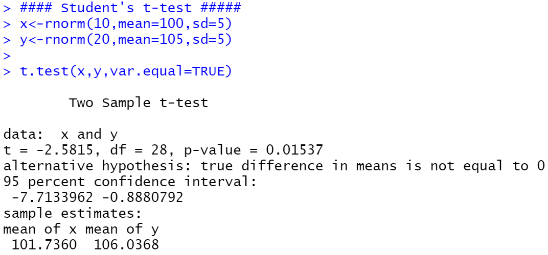
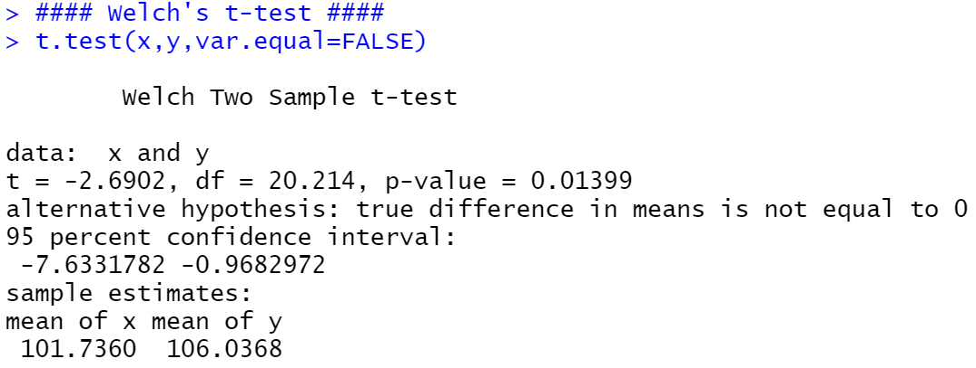
Welch’s t-test
It assumes normal distribution.
When the equal population variance assumption is not justified in Student’s t-test, Welch’s t-test can be used.
Welch's t-test does not assume equal variance, and is a more robust variation of Student's t-test.

Slide 31
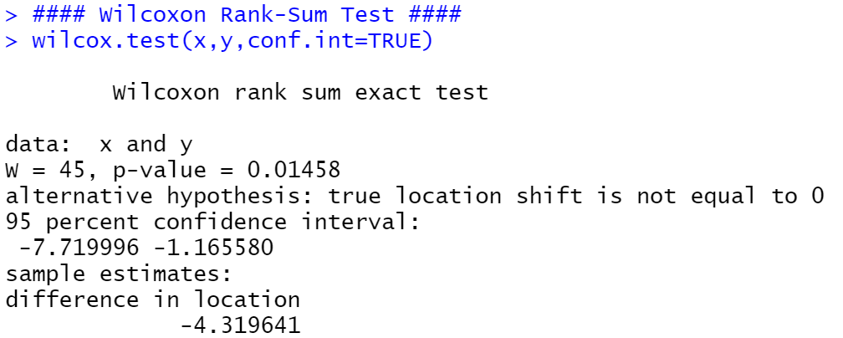
Wilcoxon Rank Sum Test
t-test assumes that the populations are normally distributed
represents a parametric test
sometimes this is close to true, sometimes not
Wilcoxon Rank Sum test
makes no assumption about the distributions of the populations
represents a nonparametric test
more robust test for different means
if p-value is small: reject the null hypothesis (equal means)

